Slide 1
Overview

Slide 2
Topics discussed in class so far
Web markup language
What is HTML?
What is XHTML?

Slide 3
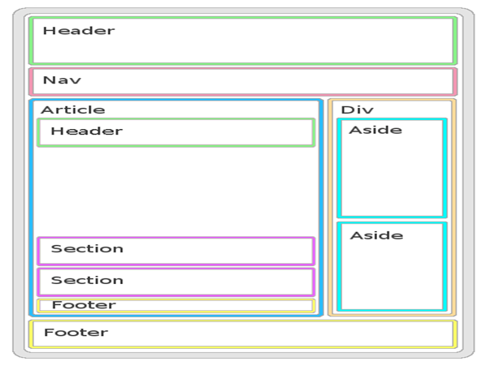
Simple Structure of HTML

Slide 4
Editors
Where to write HTML programs?
How to compile those programs?

Slide 5
HTML BASICS
Html documents
Html headings
Html Paragraphs
Html Links
Html Images
Html Buttons
Html List

Slide 6
HTML Attributes
What are Attributes?
Comments in HTML.
Tables in HTML
Forms in HTML

Slide 7
HTML 5 Add-ons
What are new Add-ons?
Graphics(canvas)
SVG
Video
Audio
Summary
Meter

Slide 8
CSS-CASCADING STYLE SHEETS
What is CSS?
Why CSS is required?
How CSS can be defined?
Different types of CSS
What can be achieved with the help of CSS?
Unit types

Slide 9
Positioning in CSS
Absolute Positioning
Fixed Positioning
Relative Positioning

Slide 10
Clipping
What is clipping?
How can it be achieved?
Where it can be used?

Slide 11
Other important features
Hover
Button styling
Text alignment
Text decoration
Background definition
Coloring property
List style
Table style
Many…

Slide 12
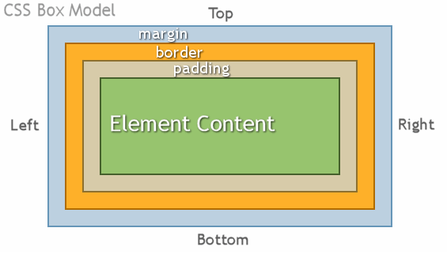
Box model

Slide 13
CSS EFFects
Transformations
Shadows for box and text
Animation
Rounded corner
Border images

Slide 14
Web layout
What is a web layout?
How is it achieved?
How effectively <div> tags are used?
Partition of web layout representation
Based on Grid

Slide 15
Responsive Web
What is Responsive web?
Based on pixel value
Size of the screen represents the website partition size.
Makes images in the website more prominent.

Slide 16
Example
So how are these done?
Screen shot of these .

Slide 17
Java Script

Slide 18
JS
What is a JS?
Why should we use it?
Is Java and JS same?
Where to write JS?

Slide 19
JS
Variables in JS
Data types
Multi-paradigm ( OO and Functional code)
Arrays
Object Literals
What are objects?
How are they created?
Arrays as objects.

Slide 20
JS
Functions in JS
Scope of variable
Constructor function

Slide 21
JS
How to access the elements in HTML using JS?
Example.

Slide 22
JS
Alert box
Confirm box
Prompt box
Calculation function

Slide 23
DOM
What is DOM?
Why use DOM?
How to use DOM?
GetElements- by ID, class,Tags.
Radio button
Select box

Slide 24
Events
What are events?
How are they done?
Why are they required?

Slide 25
FORM VALIDATION
What is a form?
Why validation?
How to validate?
What to validate?

Slide 26
Types of validation
Basic validation
Data format validation
How are they done?
Regular Expression
Example

Slide 27
Validation
What is RE?
Example
How to write a RE?
RE methods
Tips for Proper easy validation.

Slide 28
Dynamic and Static data
Timing events
Image slider
Cookies

Slide 29
UI/UX
What is UI?
What is UX?
Why it is important?
How to get good UI and UX?

Slide 30
XHTML
What is XHTML?
When can we use it?
Why it is not used popularly?

